Slide 1

Software Engineering
Tenth Edition
Chapter 23
Project planning
Copyright © 2016, 2011, 2006 Pearson Education, Inc. All Rights Reserved
Notes:
If this PowerPoint presentation contains mathematical equations, you may need to check that your computer has the following installed:
1) MathType Plugin
2) Math Player (free versions available)
3) NVDA Reader (free versions available)

Slide 2
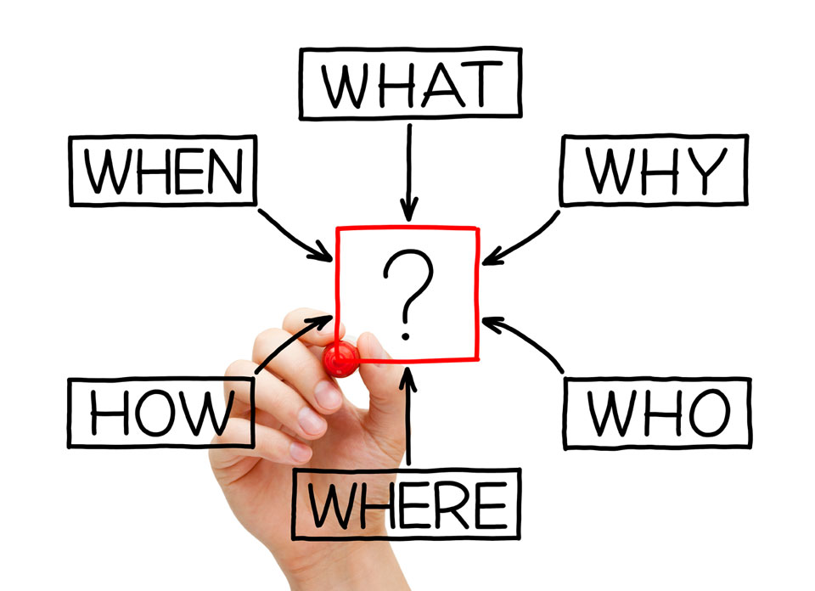
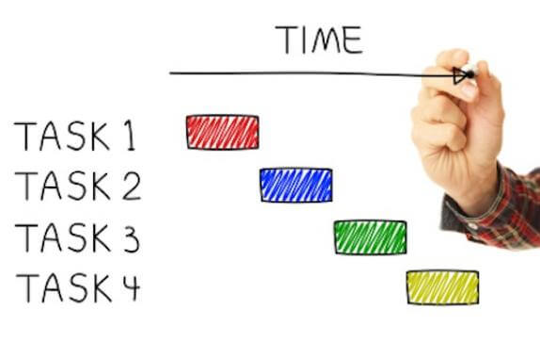
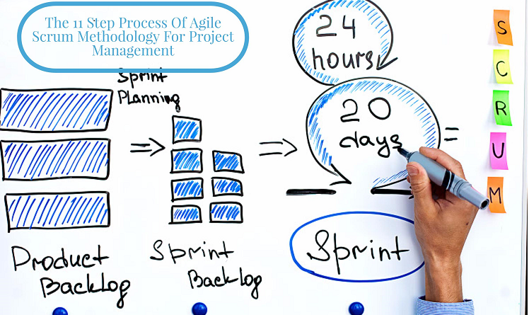
Learning Objectives
Project Planning
Project scheduling
Agile planning

Slide 3
Project Scheduling

Slide 4
Project Scheduling (What)
Project scheduling is the process of deciding how the work in a project will be organized as ______________, and when and how these tasks will be executed.
Estimate for each task
Calendar time needed to complete each task,
the effort required and
who will work on the tasks that have been identified.
Resources needed to complete each task
separate tasks

Slide 5

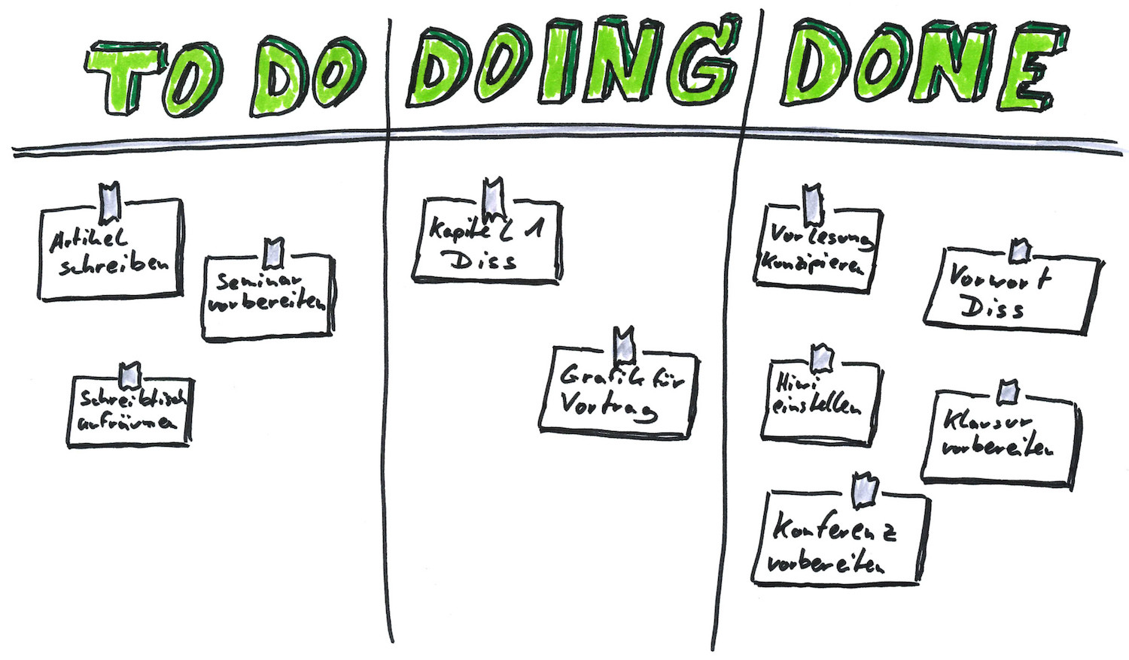

Project Scheduling Activities(How)
Split project into tasks and
Estimate time and resources required to complete each task.
Minimize task dependencies to avoid delays caused by one task waiting for another to complete.
Organize tasks concurrently to make optimal use of workforce.

Slide 6
The Project Scheduling Process

Slide 7
Scheduling Problems
Difficulty/Cost: Estimating the difficulty of problems and hence the cost of developing a solution is hard.
Productivity: Productivity is not proportional to the number of people working on a task.
Communication overheads: Adding people to a late project makes it later because of communication overheads.
Contingency: The unexpected always happens. Always allow contingency in planning.

Slide 8
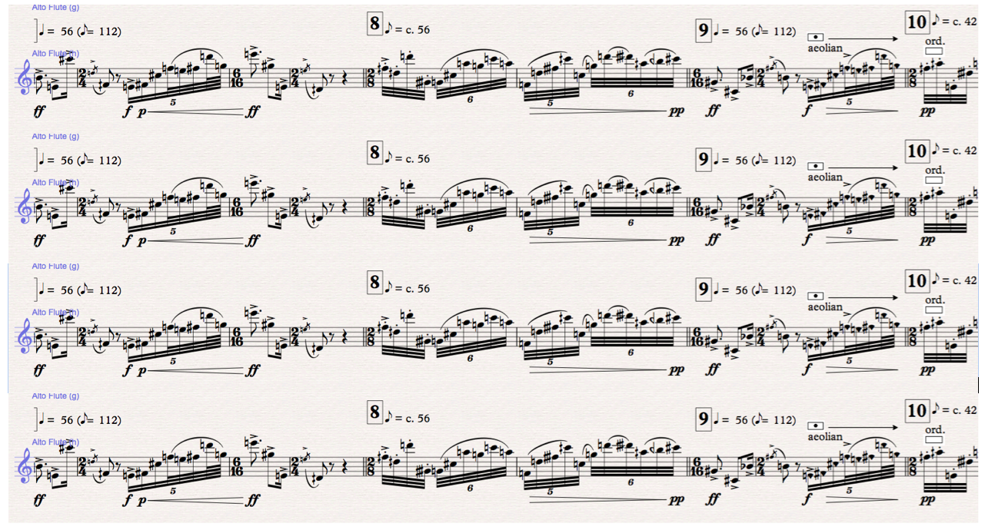
Schedule Presentation
Graphical notations are normally used to illustrate the project schedule.
Task period: These show the project breakdown into tasks. Tasks should not be too small. They should take about a week or two.

Slide 9
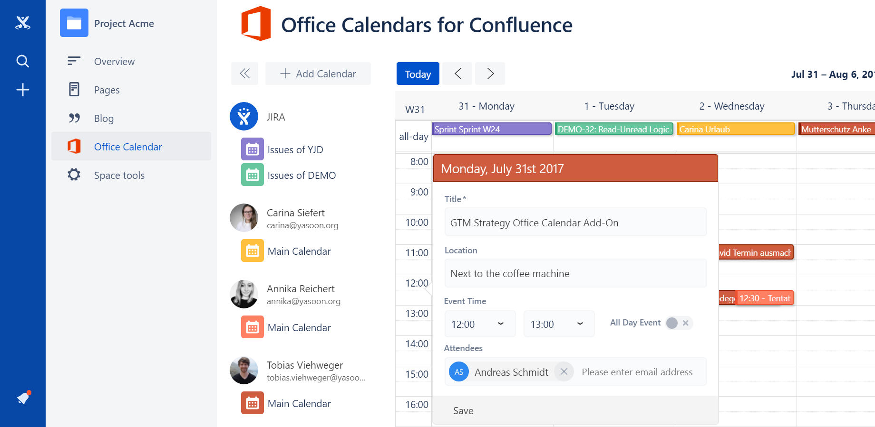
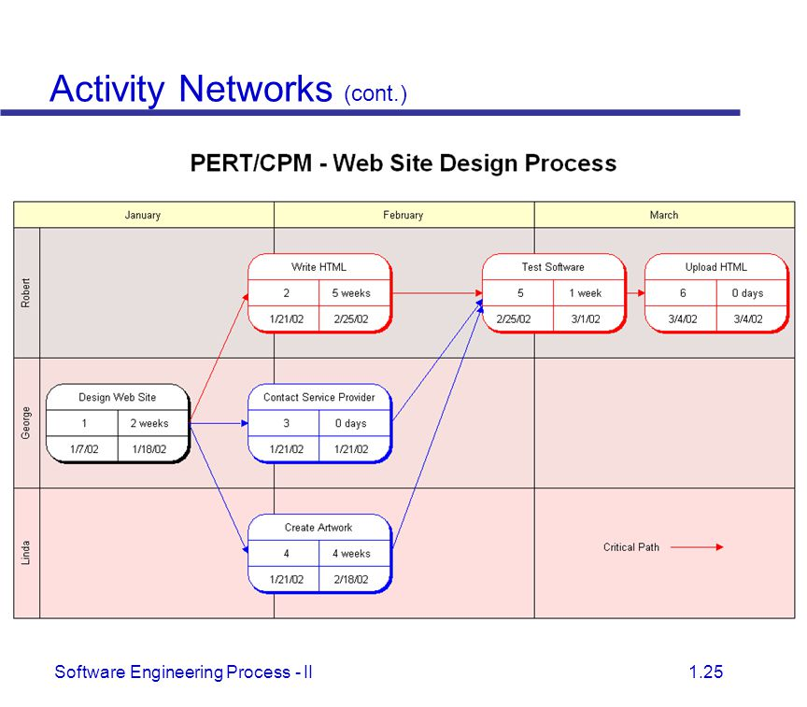
Schedule Presentation
Calendar-based
Bar charts are the most commonly used. They show the schedule as activities or resources against time.
Activity networks
Show task dependencies

Slide 10
Project Tasks
Project tasks are the basic planning element. Each has:
A duration : in calendar days or months,
An effort estimate, which shows the number of person-days or person-months to complete the work,
A deadline: by which the activity should be complete,
A defined end-point, which might be a document, the holding of a review meeting, the successful execution of all tests, etc.

Slide 11


Milestones and Deliverables
Milestones are points in the schedule against which you can assess progress
Deliverables are work products that are delivered to the customer

Slide 12
Tasks, Durations, and Dependencies
Task | Effort (person-days) | Duration (days) | Dependencies
T1 | 15 | 10 | blank
T2 | 8 | 15 | blank
T3 | 20 | 15 | T1 (M1)
T4 | 5 | 10 | blank
T5 | 5 | 10 | T2, T4 (M3)
T6 | 10 | 5 | T1, T2 (M4)
T7 | 25 | 20 | T1 (M1)
T8 | 75 | 25 | T4 (M2)
T9 | 10 | 15 | T3, T6 (M5)
T10 | 20 | 15 | T7, T8 (M6)
T11 | 10 | 10 | T9 (M7)
T12 | 20 | 10 | T10, T11 (M8)

Slide 13
Activity Bar Chart

Slide 14
Staff Allocation Chart

Slide 15
Agile Planning

Slide 16
Agile Planning
The customer’s priorities and requirements change so it makes sense to have a flexible plan that can accommodate these changes.

Slide 17
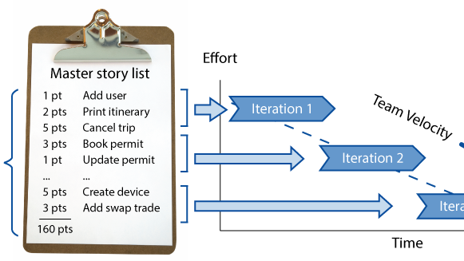
Agile Planning Stages
Stage1: Release planning
looks ahead for several months
decides on the features that should be included

Slide 18
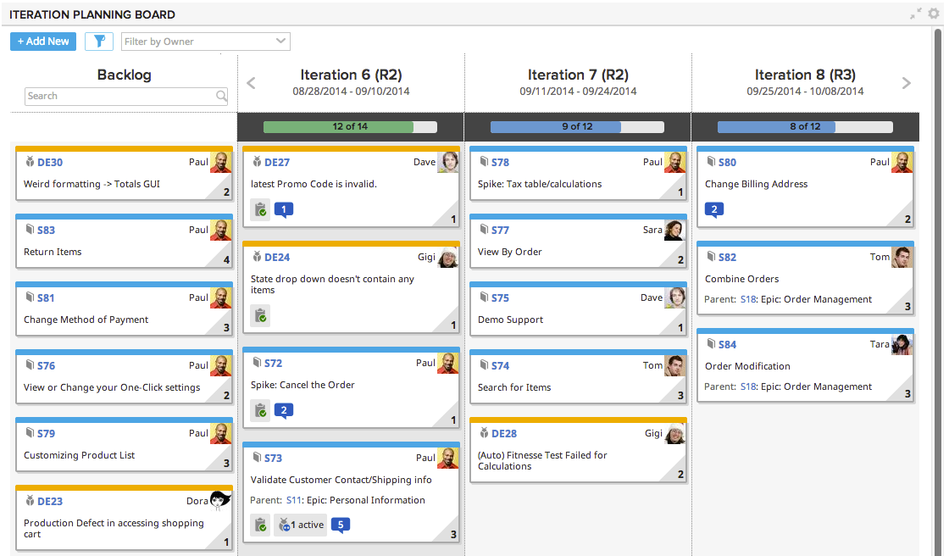
Agile Planning Stages
Stage2: Iteration planning
it has a shorter term outlook, and focuses on planning the next increment of a system.
typically 2-4 weeks of work for the team.

Slide 19
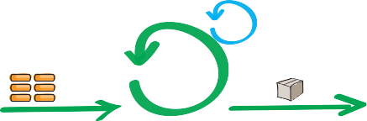
Approaches to Agile Planning
Stage 1:
Establish the general objectives
Design the software architecture.
Backlog
Stage 2:
A series of sprint cycles, where each cycle develops an increment of the system.
Stage 3:
Closure phase wraps up the project

Slide 20
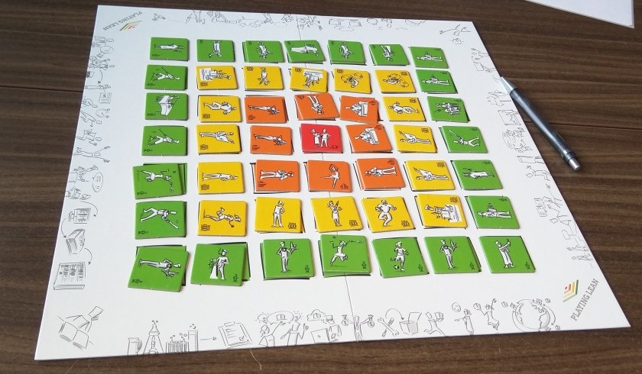

Story-based Agile Planning
1. Stories: based on user stories that reflect the features that should be included in the system.
2. Rank: rank them in order of the amount of time they think it will take to implement the story.

Slide 21


Story-based Planning Cont.
3. Effort points: Stories are assigned ‘effort points’ reflecting their size and difficulty of implementation
4. Measure: The number of effort points implemented per day is measured giving an estimate of the team’s ‘velocity’

Slide 22
The Planning Game
Release planning involves:
Stories: selecting and refining the stories that will reflect the features to be implemented in a release
Order: the order in which the stories should be implemented.
Iteration planning:
Stories: Stories to be implemented in each iteration are chosen
Number: With the number of stories reflecting the time to deliver an iteration (usually 2 or 3 weeks).

Slide 23
The Planning Game Cont.
The developers break down stories into development tasks.
A development task should take 4-16 hours.
All of the tasks that must be completed to implement all of the stories in that iteration are listed.
The individual developers then sign up for the specific tasks that they will implement.
Benefits:
The whole team gets an overview of the tasks to be completed in an iteration.

Slide 24
Benefit: Software Delivery
A software increment is always delivered at the end of each project iteration.
If the features to be included in the increment cannot be completed in the time allowed, the scope of the work is reduced.
The delivery schedule is never extended.

Slide 25
Agile Planning Difficulties
Agile planning is reliant on customer involvement and availability
This can be difficult to arrange, as customer representatives sometimes have to prioritize other work and are not available for the planning game.
Furthermore, some customers may be more familiar with traditional project plans and may find it difficult to engage in an agile planning process.

Slide 26
Software you may use for management
https://trello.com/
https://taiga.io/

Slide 27
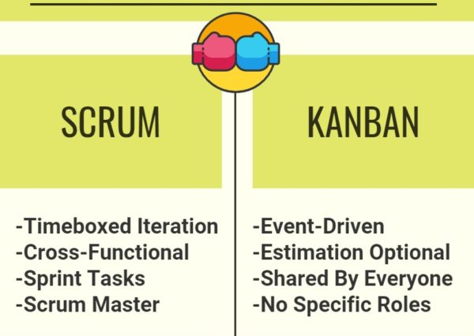
News
Agile management: Scrum, Kanban or both?

